Slide 1
Computational Photography
Project Review 1
HDR Video Reconstruction
Date : 22 - 04 - 2021
Shital (EE20S052) | Rahul (EE20S136) | Shrisudhan (ME17B122)

Slide 2
Complete Problem Statement
Task-1 Problem Statement
Generate HDR video from images acquired using coded exposure sensor.
The HDR video is expected to have sufficient spatial and temporal resolution.
Simulate multiple LDR exposure from a HDR video dataset and add signal-dependent poisson noise and signal-independent gaussian noise.
Estimate optical flow from successive frames with different exposure. Spatially align the LDR exposures based on the estimated optical flow.
Retrieve the HDR image from the aligned LDR images.

Slide 3
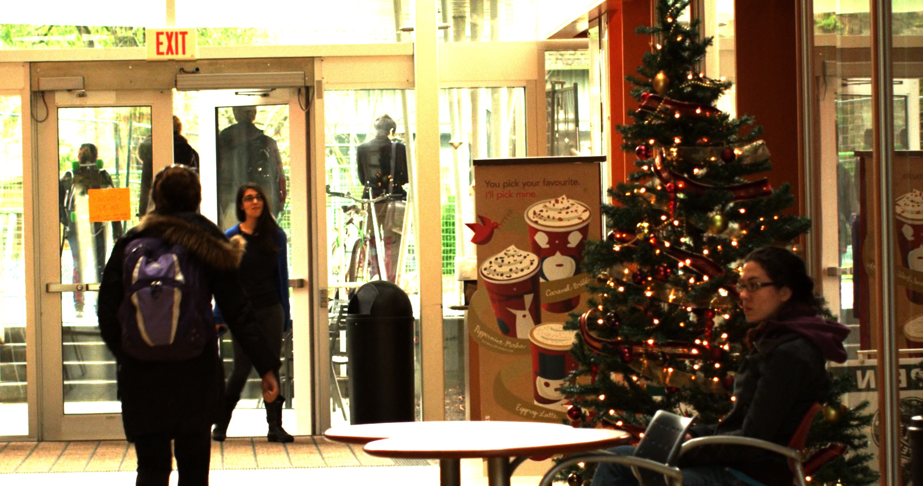
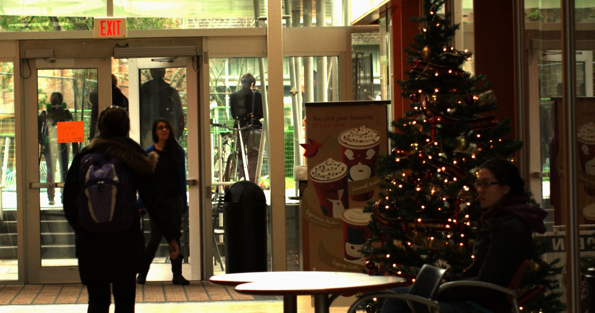
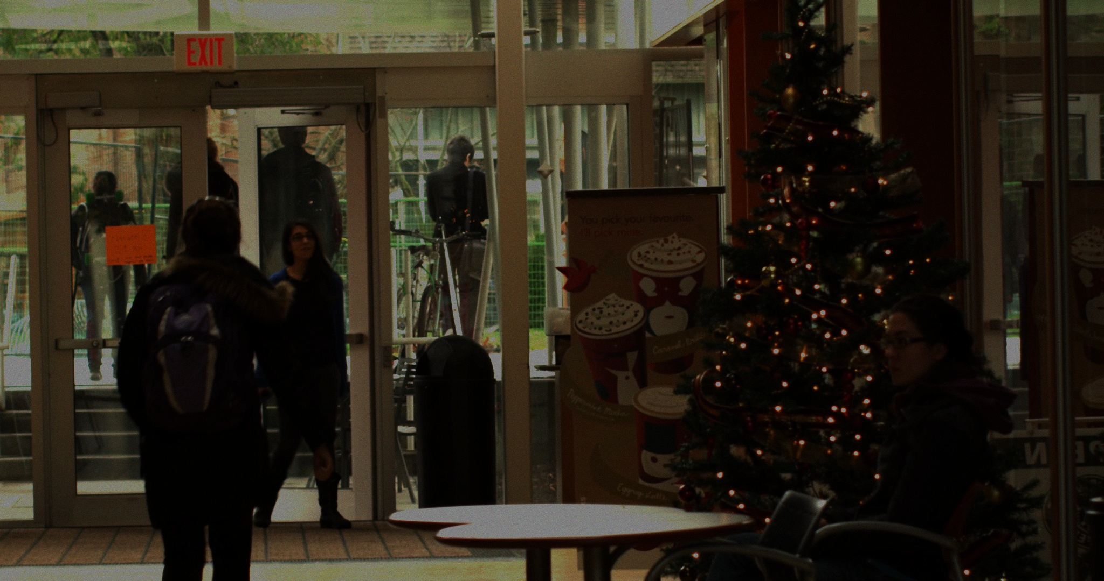
Generation of LDR from HDR
Generation of LDR images from HDR is a straightforward. The procedure is:
Take with frame with minimal exposure and limit the pixel with the largest irradiance to have an intensity value of 63.
The intensity is scaled proportionally for other exposures.
Signal dependent poisson noise and signal independent gaussian noise is added to each frame.

Slide 4
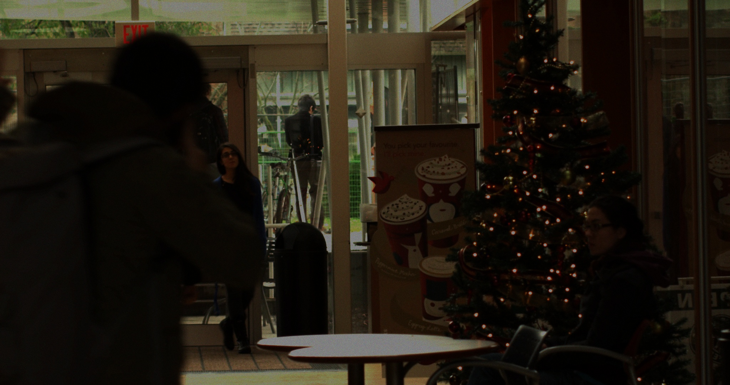
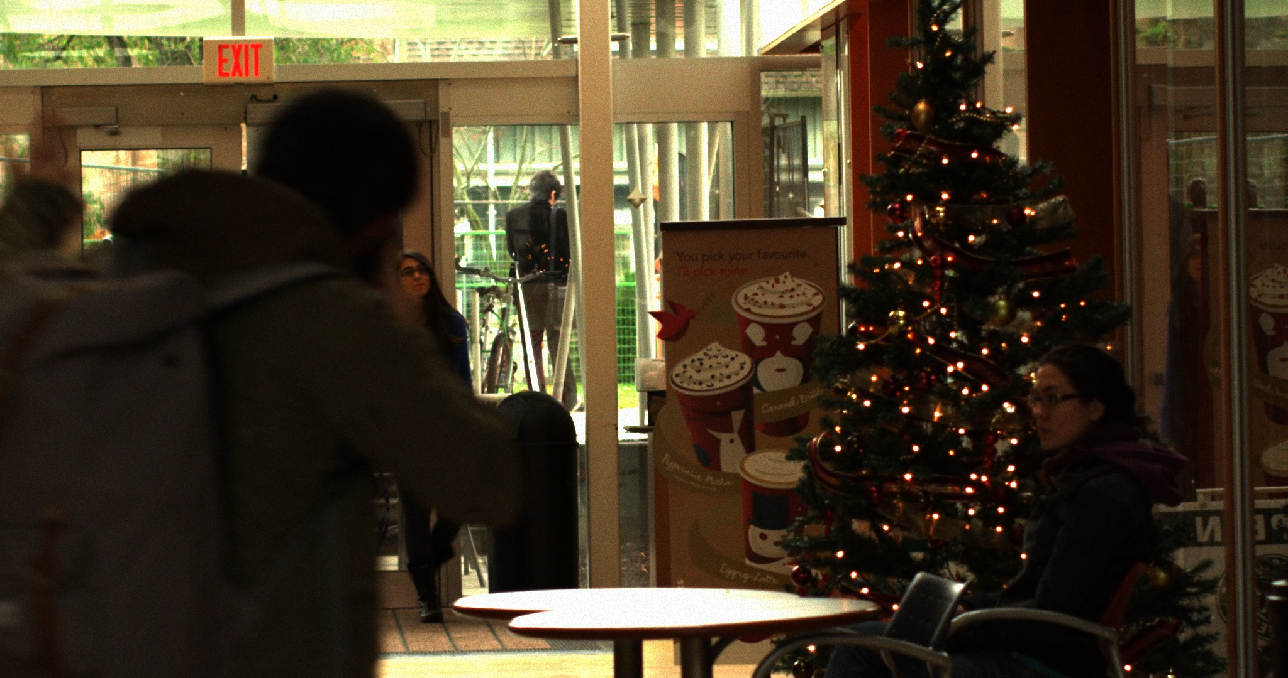
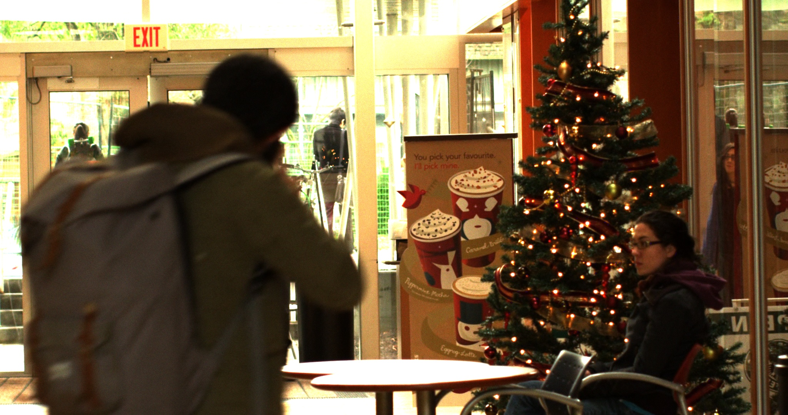
Alignment of Frames
Since the LDR exposures are captured at different temporal instances, it becomes necessary to align the frames before retrieving the HDR image.
For this we use Farneback algorithm(conventional algorithm) and Global Motion Aggregation network(DL network) to estimate the optical flow between two frames.

Slide 5
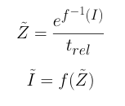
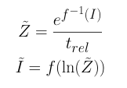
Exposure Alignment
For estimating exposures it is important to have LDR images of similar exposures. So, it becomes important to bring the neighbouring frames to a single exposure before estimating optical flow.
where f denotes the CRF function, I is the LDR image, t_{rel} is the ratio of exposure between the two exposures.

Slide 6
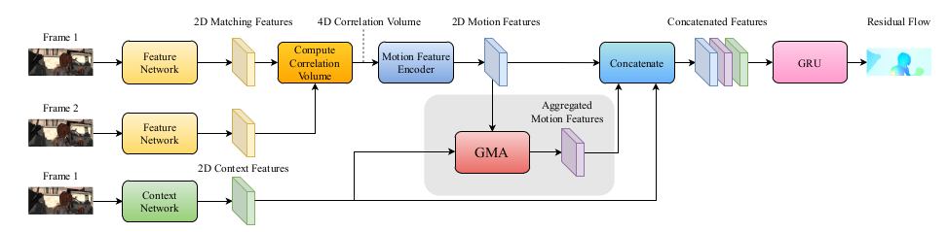
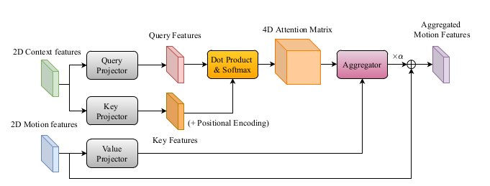
Global Motion Aggregation based network
Network Architecture
GMA module

Slide 7
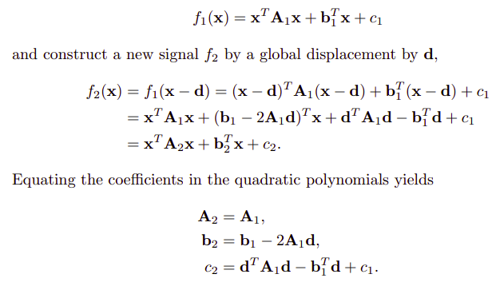
Farneback Optical Flow Algorithm
In this method, a neighbourhood in an image is expressed using polynomial expression as

Slide 8
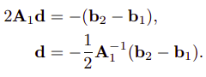
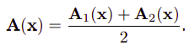
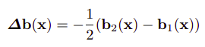
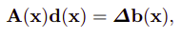
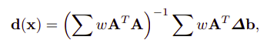
Farneback Optical Flow Algorithm (continued)
Rearranging equation for finding b₂
Practically A₁ and A₂ are not the same, hence we approximate it as
Consider
Above eqn could be rewritten as
To improve accuracy and reduce noise, we consider a patch, weigh it and solve the equation

Slide 9
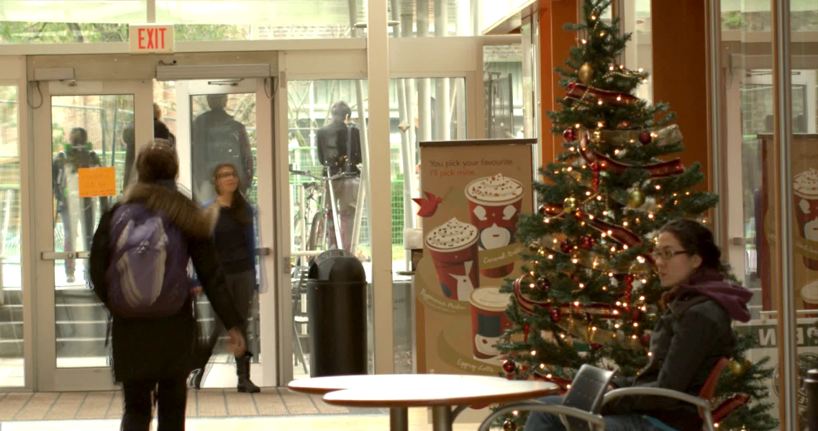
HDR image retrieval
The spatially aligned frames are used to generate HDR images based on the Debevec’s algorithm explained in course lectures.
The HDR image then undergoes tone-mapping to generate displayable image.
Tone-mapped HDR output

Slide 10
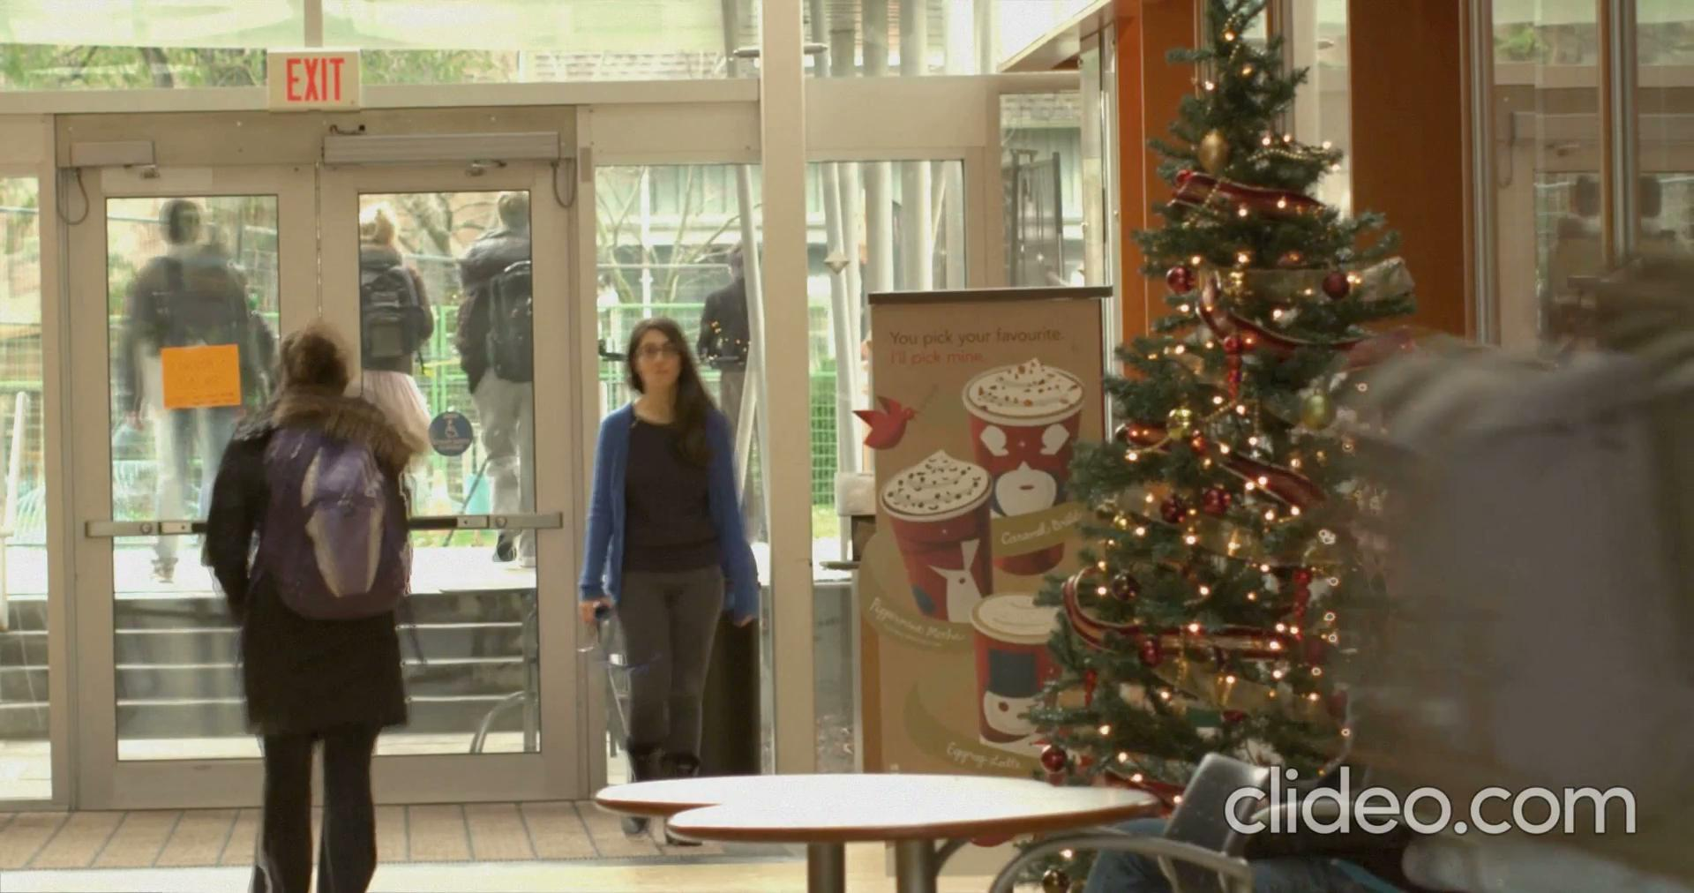
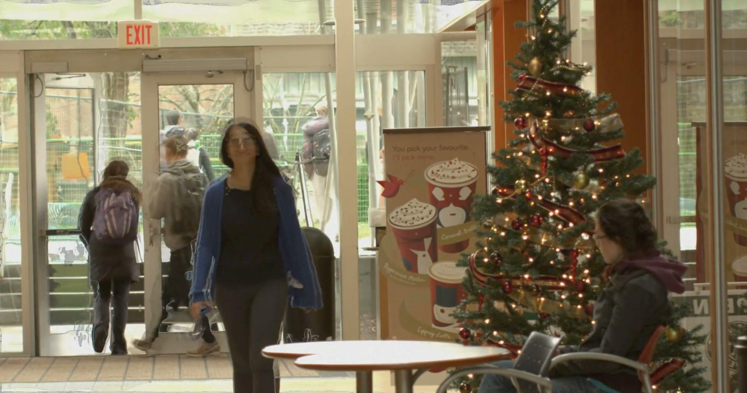
Results
GMA network Farneback algorithm

Slide 11

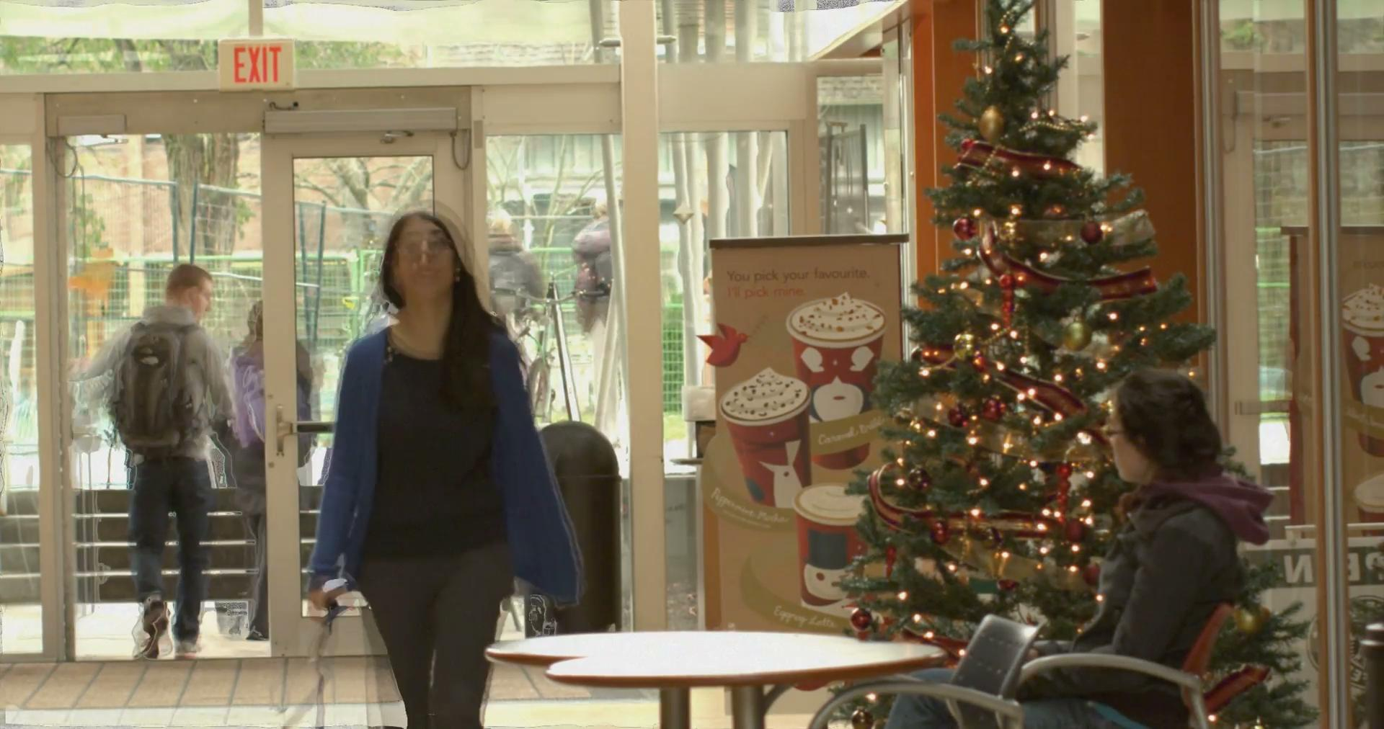
Results
GMA network Farneback algorithm

Slide 12
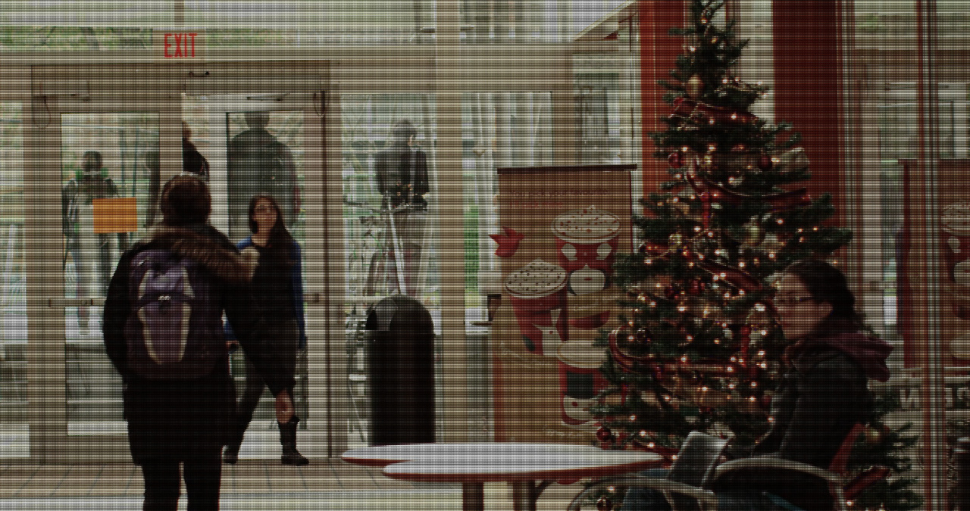
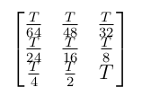
Coded Exposure Generation
Bayer filter

Slide 13
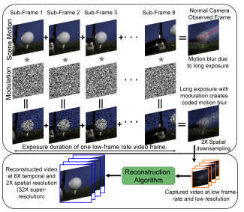
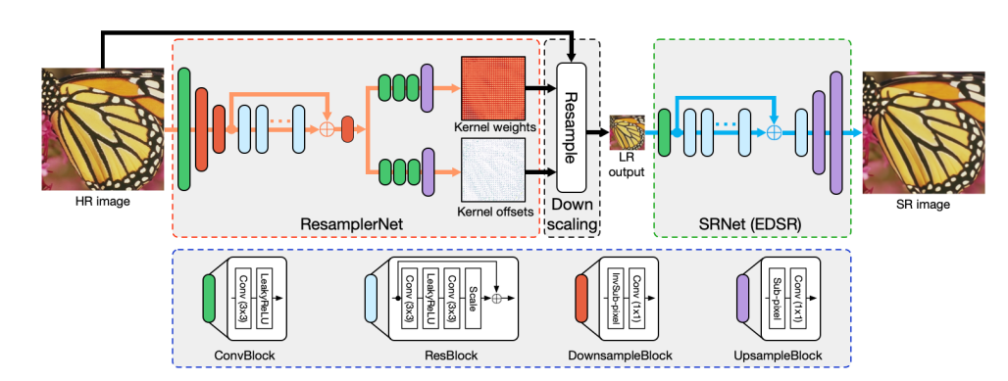
Proposed plan for next 2 weeks
Retrieving HDR images for coded exposure generated using P2C2 algorithm. Increase the temporal resolution to avoid motion blur.
Increase the spatial resolution of the generated HDR image using super resolution networks.
P2C2 algorithm Super-resolution network

Slide 14
Individual Contribution
Rahul G S
LDR image generation
Farneback algorithm for optical flow estimation
Coded exposure generation
Shital Sheshrao Yelne
Tested COVID positive
Shrisudhan G
LDR image generation
Exposure alignment between different exposures
GMA network for optical flow estimation

Slide 15
THANK
YOU

